Slide 1
Principal Component Analysis
Prof. Xi Niu
University of North Carolina at Charlotte
1
Notes:
1
One of the key ideas for solving PCA with eigenvalue decomposition is that a symmetric matrix can be diagonalized by an orthogonal matrix of its eigenvectors.

Slide 2
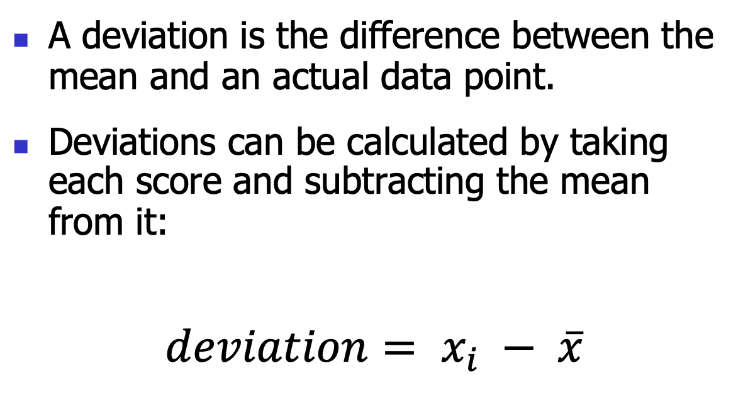
Measuring data variability: ‘Error’ = deviation
A deviation is the difference between the mean and an actual data point.
Deviations can be calculated by taking each score and subtracting the mean from it:
$$deviation= x_{i} − \overline{x}$$

Slide 3
Use the Total Error
We could just take the error between the mean and the data and add them.
Lecturer ID | Score | Mean | Deviation
1 | 1 | 2.6 | -1.6
2 | 2 | 2.6 | -0.6
3 | 3 | 2.6 | 0.4
4 | 4 | 2.6 | 0.4
5 | 4 | 2.6 | 1.4
 |  | Total

Slide 4
Sum of Squared Errors
We square each error (deviation).
If we add these squared deviations we get the sum of squared errors (SS).

Slide 5
ID | Score | Mean | Deviation | Squared Deviation
1 | 1 | 2.6 | -1.6 | 2.56
2 | 2 | 2.6 | -0.6 | 0.36
3 | 3 | 2.6 | 0.4 | 0.16
4 | 4 | 2.6 | 0.4 | 0.16
5 | 4 | 2.6 | 1.4 | 1.96
 |  |  | Total | 5.20

Slide 6
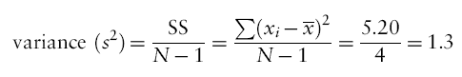
Variance
We calculate the average variability by dividing by the number of scores (n).
This value is called the variance (s²).
Notes:
Why N-1 instead of N, please see Field (2012) Page 38

Slide 7
Standard Deviation
So we take the square root value.
This is the standard deviation (s).

Slide 8
Important Things to Remember
The sum of squares, variance, and standard deviation represent the same concept:
The variability of the data
The deviation of the data from the mean
How well the mean represents the observed data
Error

Slide 9
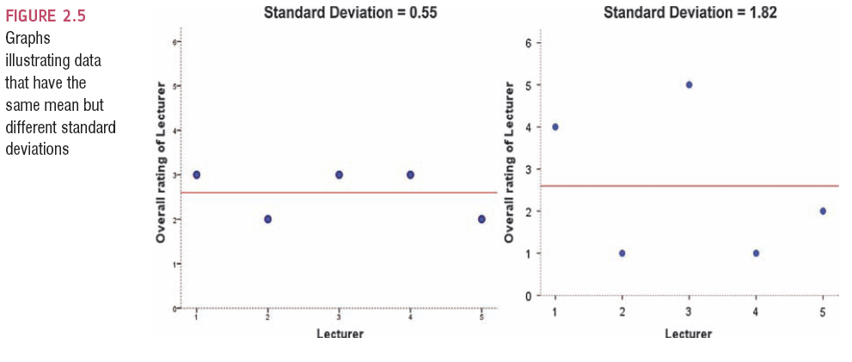
Same Mean, Different SD

Slide 10
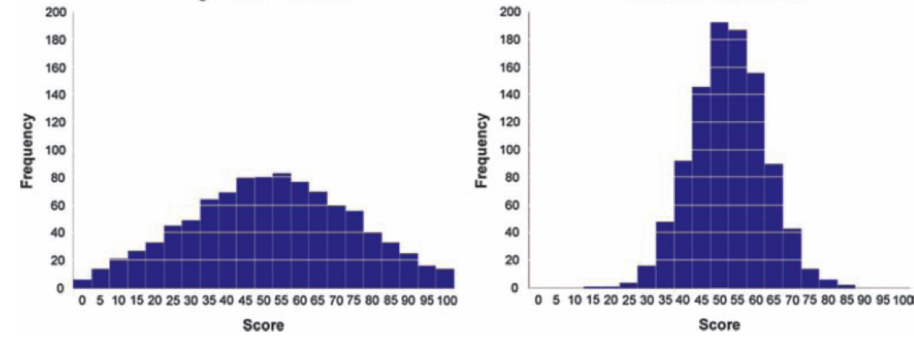
The SD and the Shape of a Distribution

Slide 11
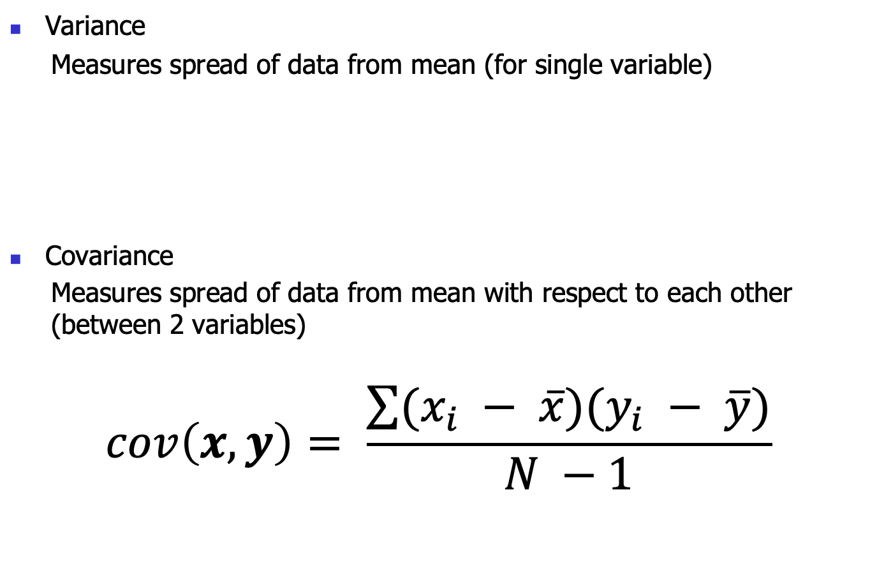
Variance and Covariance
Variance
Measures spread of data from mean (for single variable)
Covariance
Measures spread of data from mean with respect to each other (between 2 variables)
$$cov\left(x,y\right)= \frac{\sum{(x_{i} − \overline{x})(y_{i} − \overline{y})}}{N −1}$$

Slide 12
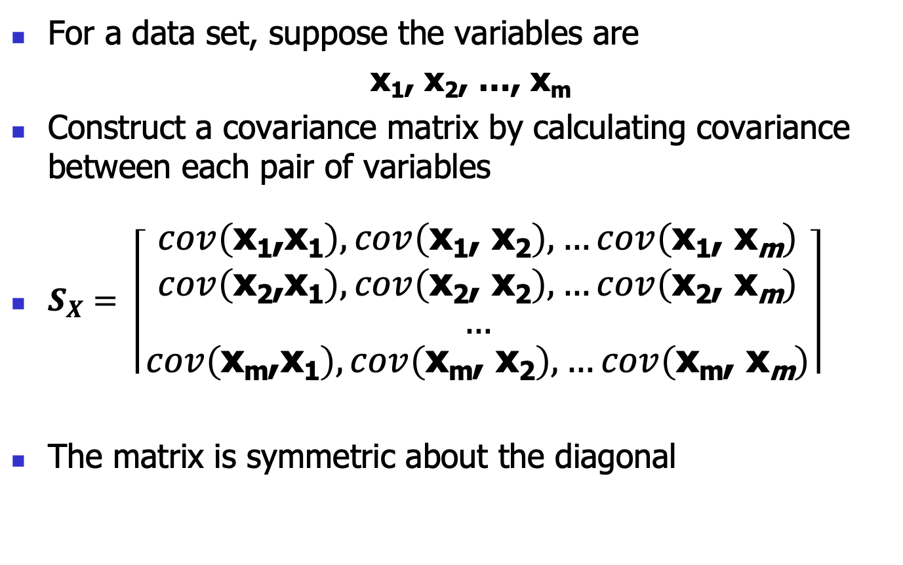
Covariance Matrix
For a data set, suppose the variables are
x₁, x₂, …, x_{m}
Construct a covariance matrix by calculating covariance between each pair of variables
$S_{X}= \left\lceil \begin{aligned}cov\left(\text{x}\text{1}\text{,}\text{x}\text{1}\right), cov\left(\text{x}\text{1}\text{, }\text{x}\text{2}\right), …cov\left(\text{x}\text{1}\text{, }\text{x}\text{m}\right) \\ cov\left(\text{x}\text{2}\text{,}\text{x}\text{1}\right), cov\left(\text{x}\text{2}\text{, }\text{x}\text{2}\right), …cov\left(\text{x}\text{2}\text{, }\text{x}\text{m}\right) \\ … \\ cov\left(\text{x}\text{m}\text{,}\text{x}\text{1}\right), cov\left(\text{x}\text{m}\text{, }\text{x}\text{2}\right), …cov\left(\text{x}\text{m}\text{, }\text{x}\text{m}\right)\end{aligned}\right\rceil$
The matrix is symmetric about the diagonal

Slide 13

Covariance Matrix (cont’d)
According to the covariance calculation formula：
$$S_{X}= \frac{1}{m −1}XX^{T}$$
Where X = [x₁,x₂,…,x_{m}], X^{T} is the transpose of X

Slide 14
PCA

Slide 15
Principal Component Analysis
It is a mathematical tool from matrix algebra
It is a method of extracting relevant information from confusing dataset
It provides a roadmap for how to reduce a complex dataset to a lower dimension

Slide 17
Example of a problem

Slide 18
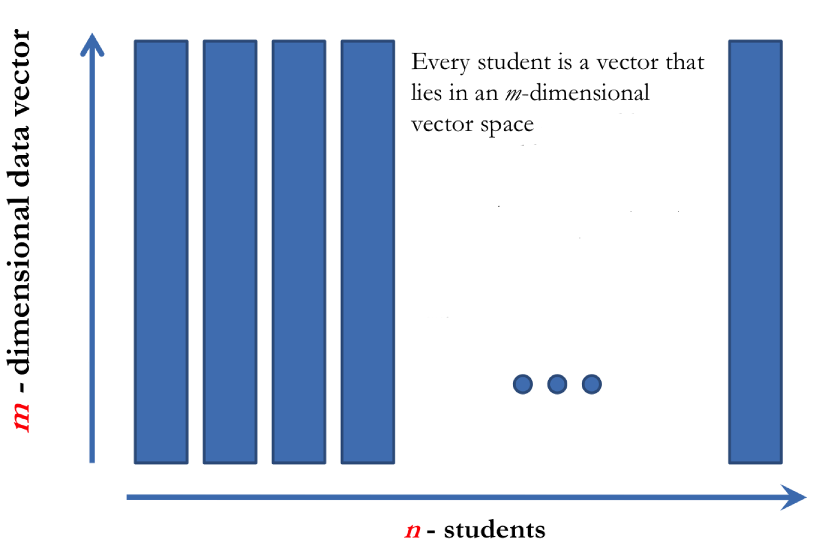
Put them in one matrix

Slide 19
Which parameters can we ignore
Redundant Parameter

Slide 20
Which parameters to keep

Slide 22
Change of Basis

Slide 23
Change of Basis

Slide 24
Geometrics
Geometrically, it’s like turning the axes
X₂
X₁

Slide 25
Important Notes on Change of Basis
Changing the basis doesn’t change the data, only its representation.
Changing the basis is actually projecting the data vectors onto the new basis vectors.
Geometrically, P is a rotation and a stretch of X
If P basis is orthonormal (usually each vector length = 1) then the transformation P is only a rotation.

Slide 26
Questions Remaining

Slide 27
Refresh Your Memory: Covariance Matrix
According to the covariance calculation formula：
$$S_{X}= \frac{1}{m −1}XX^{T}$$
Where X = [x₁,x₂,…,x_{m}], X^{T} is the transpose of X

Slide 28
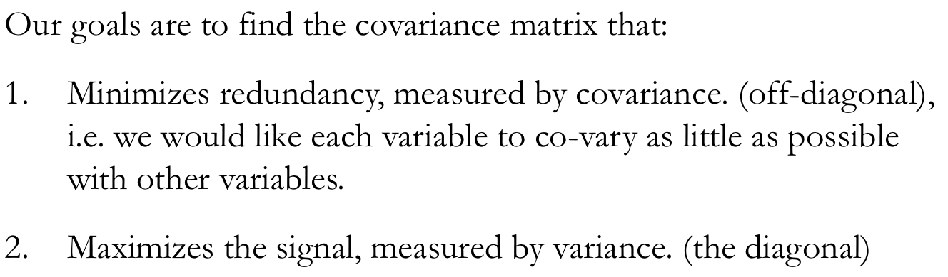
Diagonalize the Covariance Matrix
S_{Y}

Slide 29
Goals
Find some orthogonal matrix P where Y = PX such that the covariance matrix of Y (S_{Y}) is diagonalized.

Slide 30
Solving PCA: Eigenvectors of Covariance Matrix

Slide 31
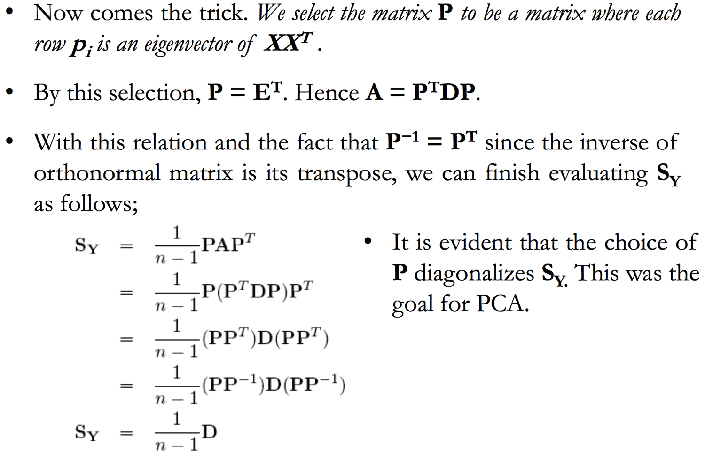

Slide 32
Change of Basis

Slide 33
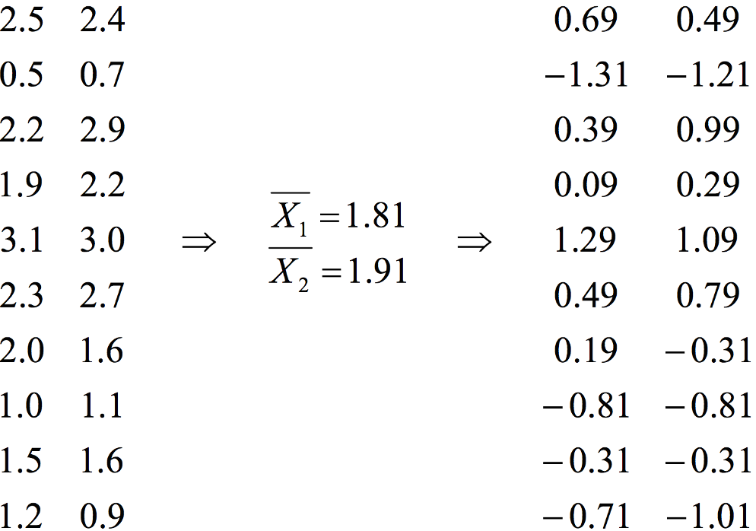
PCA – STEP 1
x₁ x₂
x’₁ x’₂
n = 10
m = 2

Slide 34
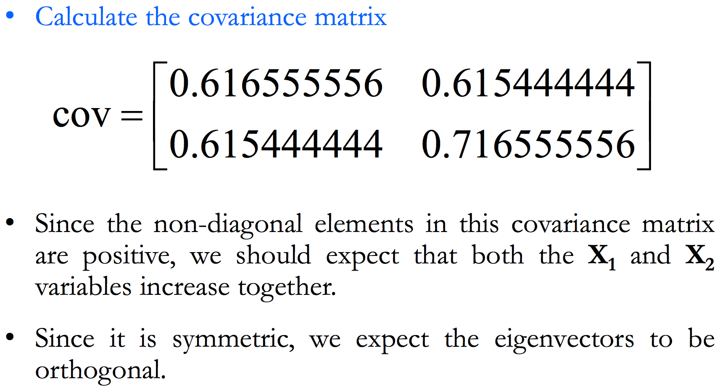
PCA – STEP 2

Slide 35
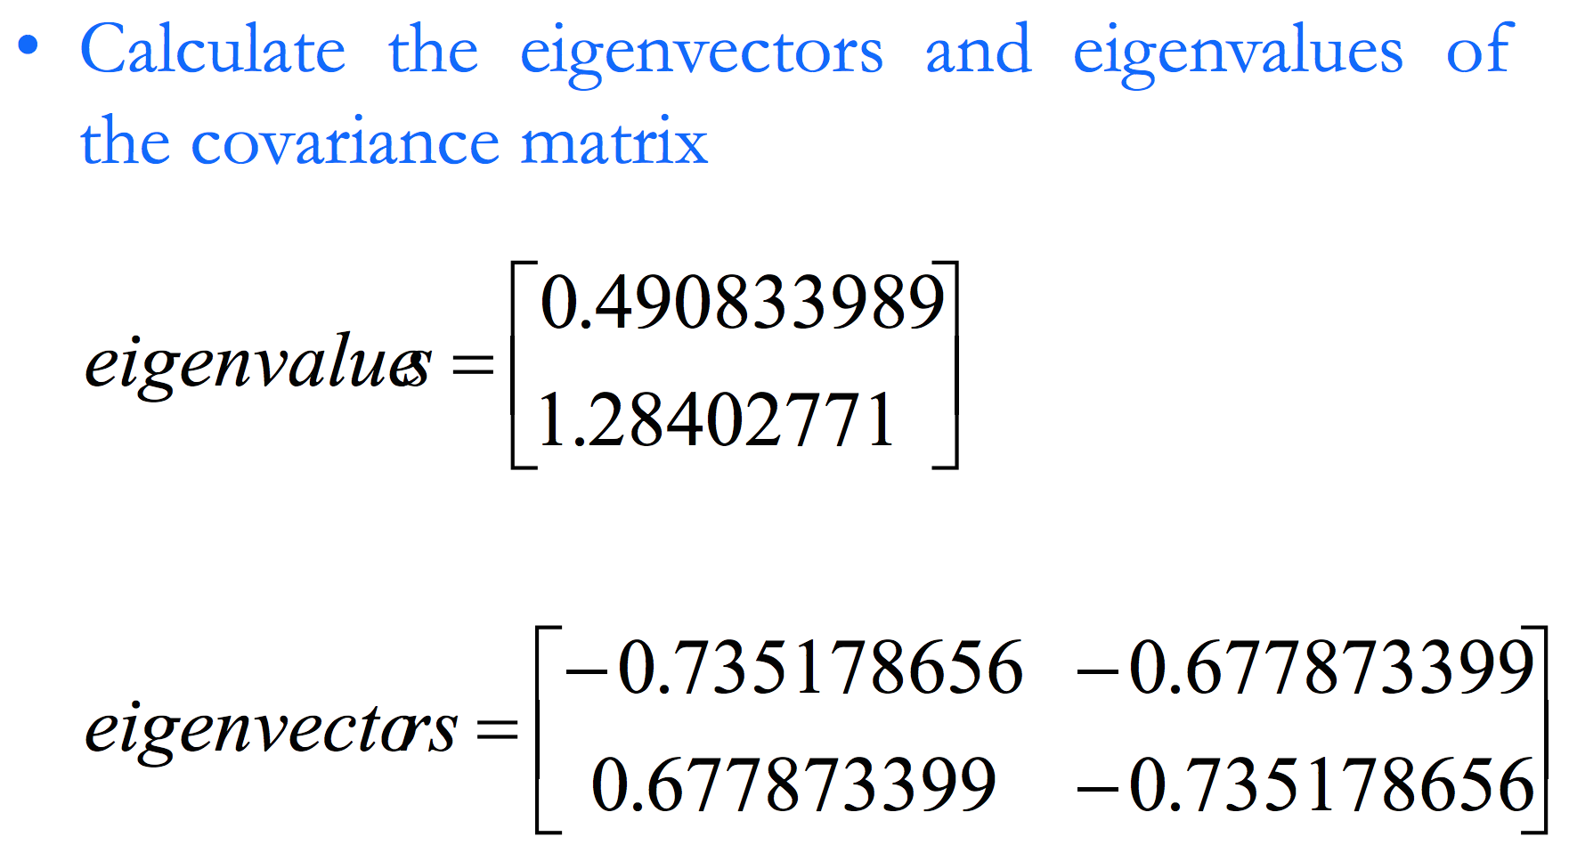
PCA – STEP 3

Slide 36
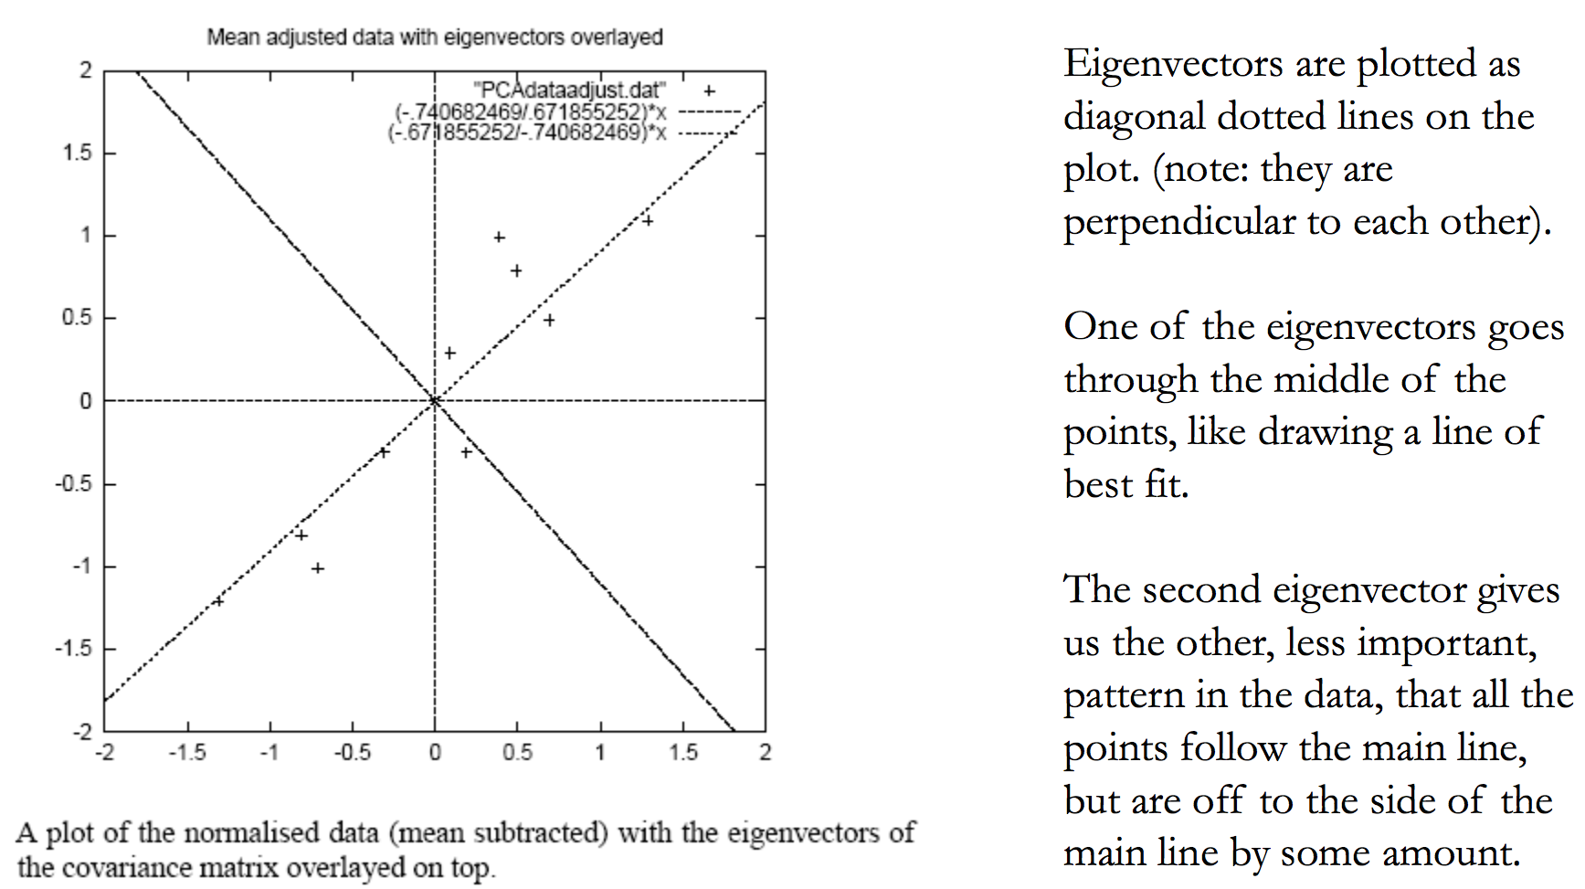
PCA – STEP 4

Slide 37
PCA – STEP 5

Slide 38
PCA – STEP 6

Slide 39
PCA – STEP 7

Slide 40
PCA – New Data

Slide 41
PCA – New Data Visualized

Slide 42
PCA Recap
The eigenvectors are principle components (PCs)
All principal components (PCs) start at the origin of the ordinate axes.
First PC is direction of maximum variance
Subsequent PCs are orthogonal to 1st PC and describe the remaining maximum residual variance
X₂
X₁
30

Slide 43
Principal Component Analysis
It is a mathematical tool from matrix algebra
It is a method of extracting relevant information from confusing dataset
It provides a roadmap for how to reduce a complex dataset to a lower dimension

Slide 44
The R anxiety questionnaire (RAQ)

